Slide 1
SAP BTP/CAP - DAY 01: Overview
Foundation of SAP Business Technology Platform

Slide 2
On-Premise Vs Cloud
In the context of SAP, on-premise means the software is installed and managed on a company's own infrastructure, while cloud deployments are hosted and managed by SAP (or a third-party provider). This difference impacts control, customization, infrastructure management, and costs.
Deployment & Infrastructure:
On-Premise: Software is installed locally on a company’s own servers and hardware.
SAP Cloud: Software is hosted and managed by SAP or a cloud provider, accessible via the internet.
Maintenance & Updates:
On-Premise: The company is responsible for maintaining the system, applying patches, and upgrades.
SAP Cloud: SAP handles all maintenance, updates, and system enhancements automatically.

Slide 3
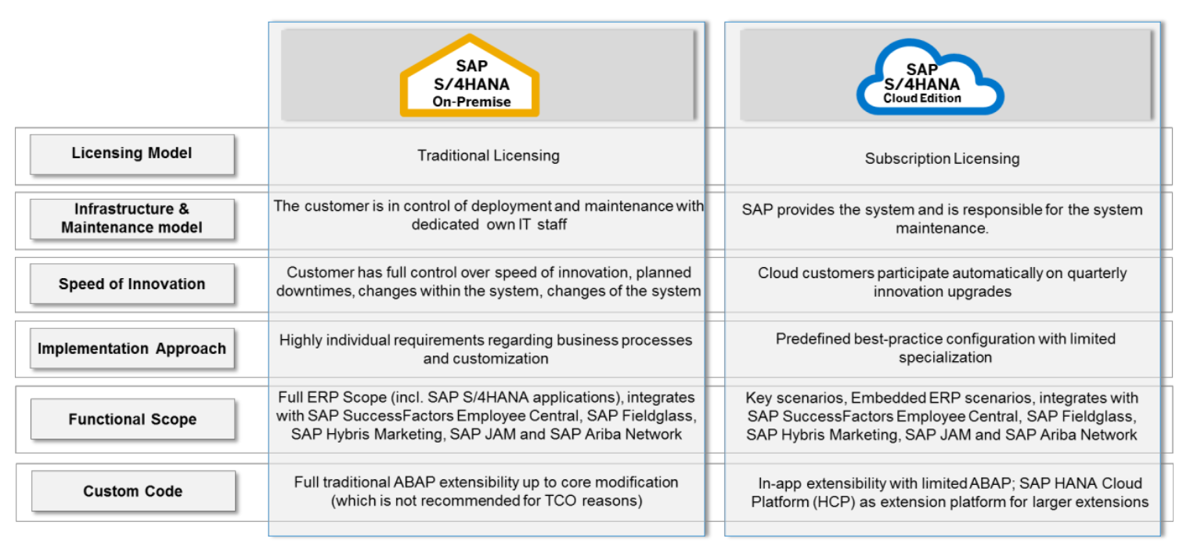

Slide 4
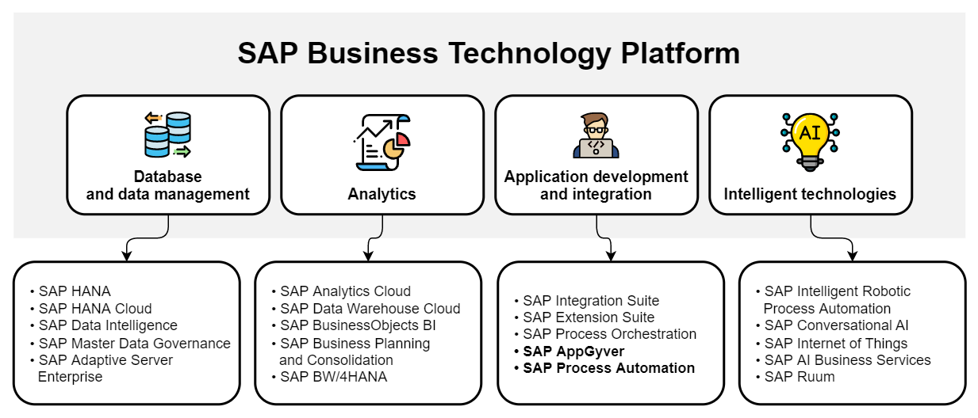
Why SAP BTP ( Cloud Platform ) ?

Slide 5
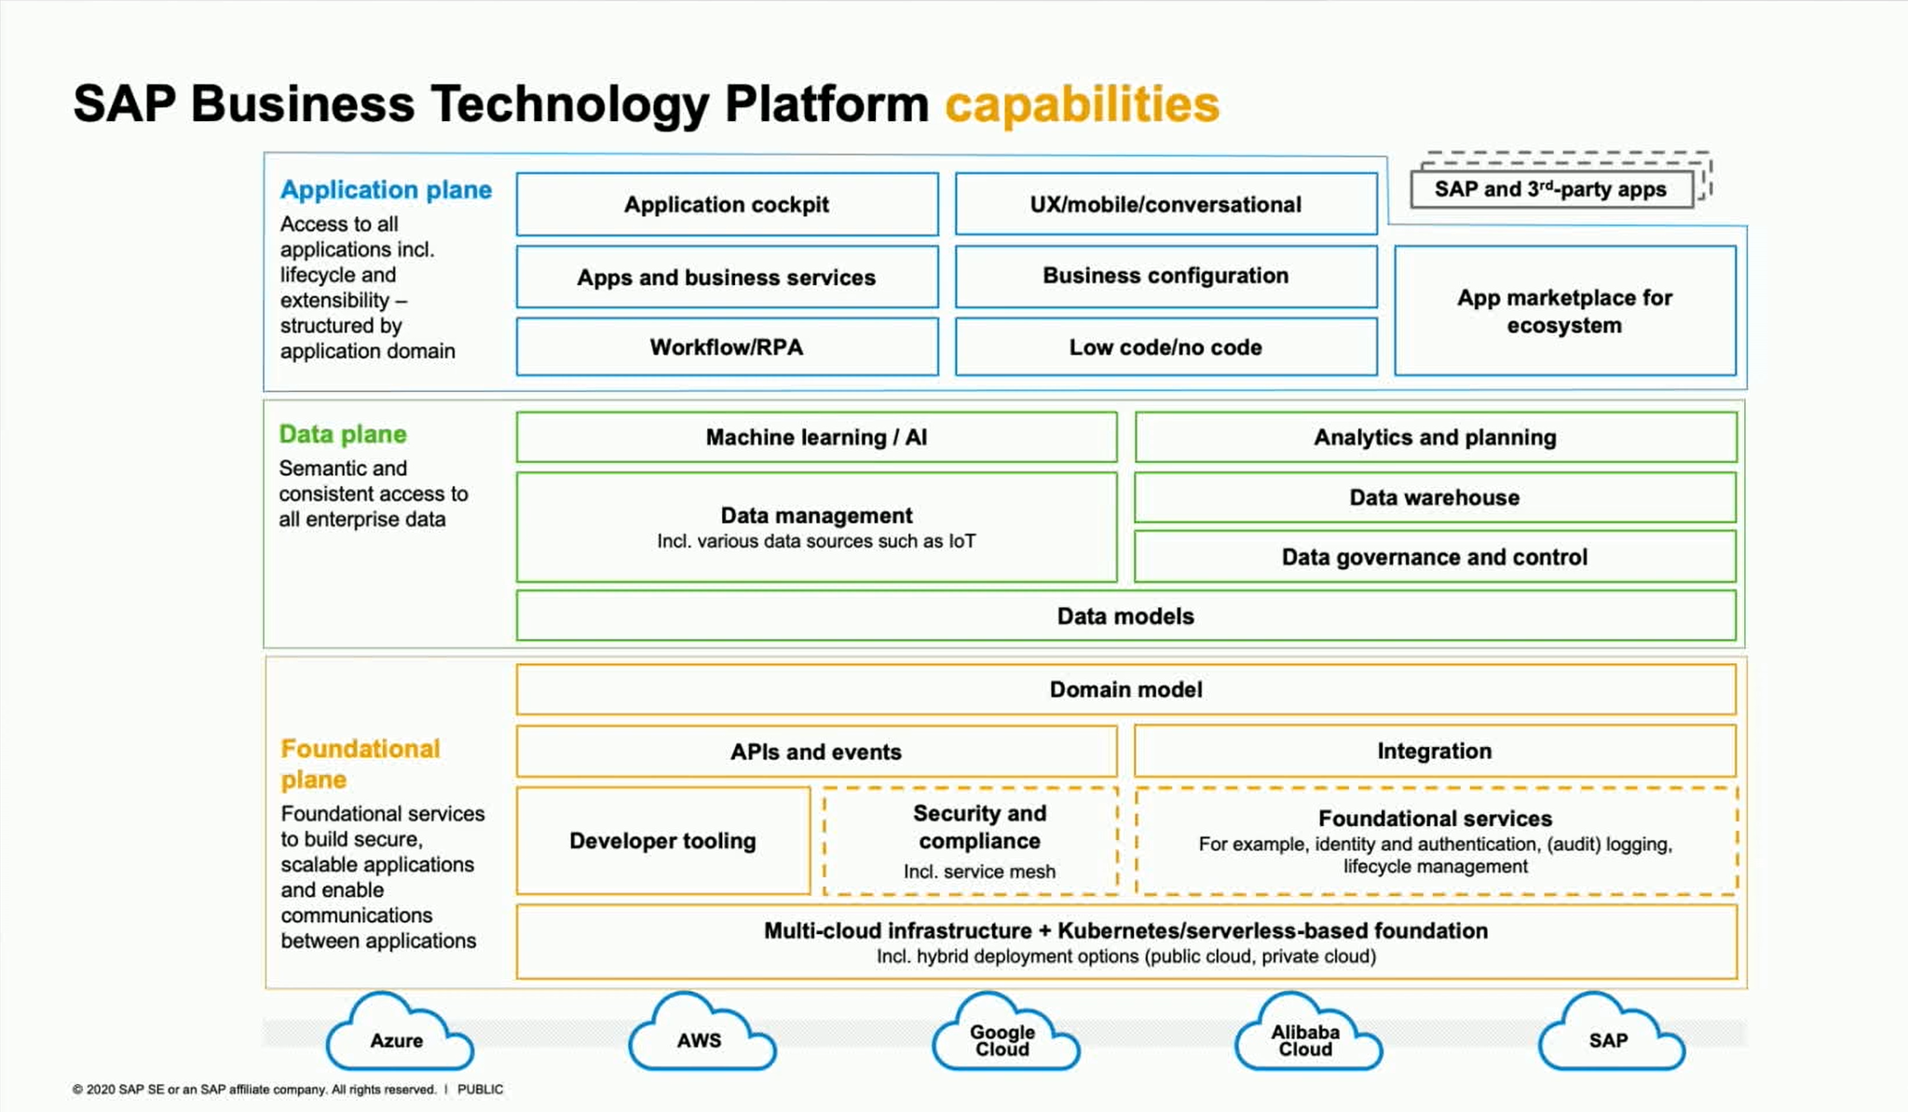

Slide 6
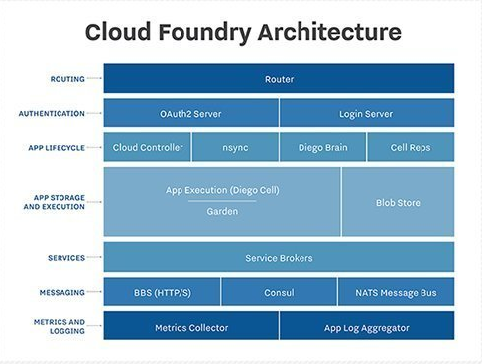
What is Cloud Foundry ?
Cloud Foundry (CF) is an open-source Platform-as-a-Service (PaaS) used to deploy, manage, and scale cloud applications easily. SAP BTP supports Cloud Foundry to run modern cloud-native apps.
Key Points about Cloud Foundry:
Multi-language support – Developers can deploy apps written in Java, Node.js, Python, Go, and more.
App-centric deployment – You just push your code (cf push), and Cloud Foundry handles the rest (infrastructure, networking, scaling).
Service marketplace – Easily bind apps to databases, messaging tools, and other services through a built-in marketplace.

Slide 7
SAP BTP & Cloud Foundry Dev Tools
1. BTP CLI
Manages global BTP accounts, entitlements, and services.
Used for account-level tasks, not app deployment.
2. CF CLI (Cloud Foundry CLI)
Used to push and manage apps in Cloud Foundry (cf push).
Essential for app lifecycle operations in SAP BTP CF.
3. Git
Version control for project source code (e.g., GitHub).
Integrated into BAS, VS Code, and CI/CD pipelines.
4. Maven
Builds Java-based CAP projects (mvn clean install).
Handles dependencies and project packaging.

Slide 8
SAP BTP & Cloud Foundry Dev Tools
5. STS / VS Code
STS: Ideal for Spring Boot & Java projects.
VS Code: Lightweight, supports CAP, UI5, and SAP extensions.
6. Jenkins
Automates build, test, deploy workflows.
Integrates with cf CLI for BTP deployments.
7. PostgreSQL
Open-source DB, available as a service in CF.
Easily bind to apps using cf bind-service.

Slide 9
SAP BTP Cockpit : 90 Days Trial Account :
SAP BTP offers a free 90-day trial account to explore its services, including Cloud Foundry, CAP, SAP HANA, and more. The SAP BTP Cockpit provides a web-based interface to manage global accounts, subaccounts, entitlements, and service instances. It’s ideal for developers to build, deploy, and test applications in a real cloud environment without cost.
Key Points:
Access to major SAP services like CAP, HANA Cloud, and Integration Suite.
Manage apps, users, and services directly from the BTP Cockpit UI.
Includes Cloud Foundry runtime for deploying apps in multiple languages.
Supports learning and prototyping with pre-configured service plans and boosters.
SAP BTP Trial Account Setup : https://www.sap.com/products/technology-platform/trial.html

Slide 10
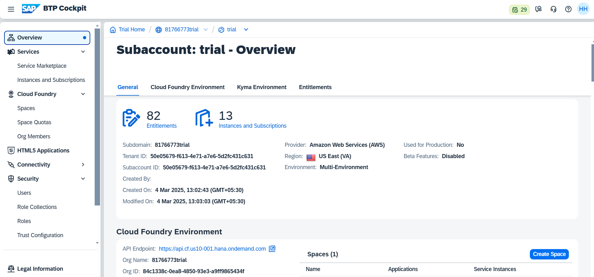
SAP BTP Cockpit : 90 Days Trial Account

